Slide 1

British Airways Customer Reviews Analysis
Customer Review & Service Quality Analysis using Tableau
Presented by: AI Presentation Designer

Slide 2

Project Overview: Enhancing Airline Customer Experience
This project leverages the power of data analytics to dissect British Airways customer reviews, transforming raw feedback into actionable insights. Our primary goal is to provide a comprehensive understanding of service quality, pinpoint areas for improvement, and identify emerging trends that influence customer satisfaction.
Goal
Analyze British Airways customer reviews to understand service quality, customer satisfaction, and emerging trends.

Slide 3


Key Objectives of Our Analysis
Overall Satisfaction
Gauge general customer sentiment towards British Airways.
Identify Trends
Uncover patterns in feedback over various periods.
Compare Performance
Analyze metrics across different countries and aircraft types.
Service Metrics
Deep dive into specific areas: Ground Service, Cabin Staff, Food & Beverages, Seat Comfort, Entertainment, and Value.

Slide 4
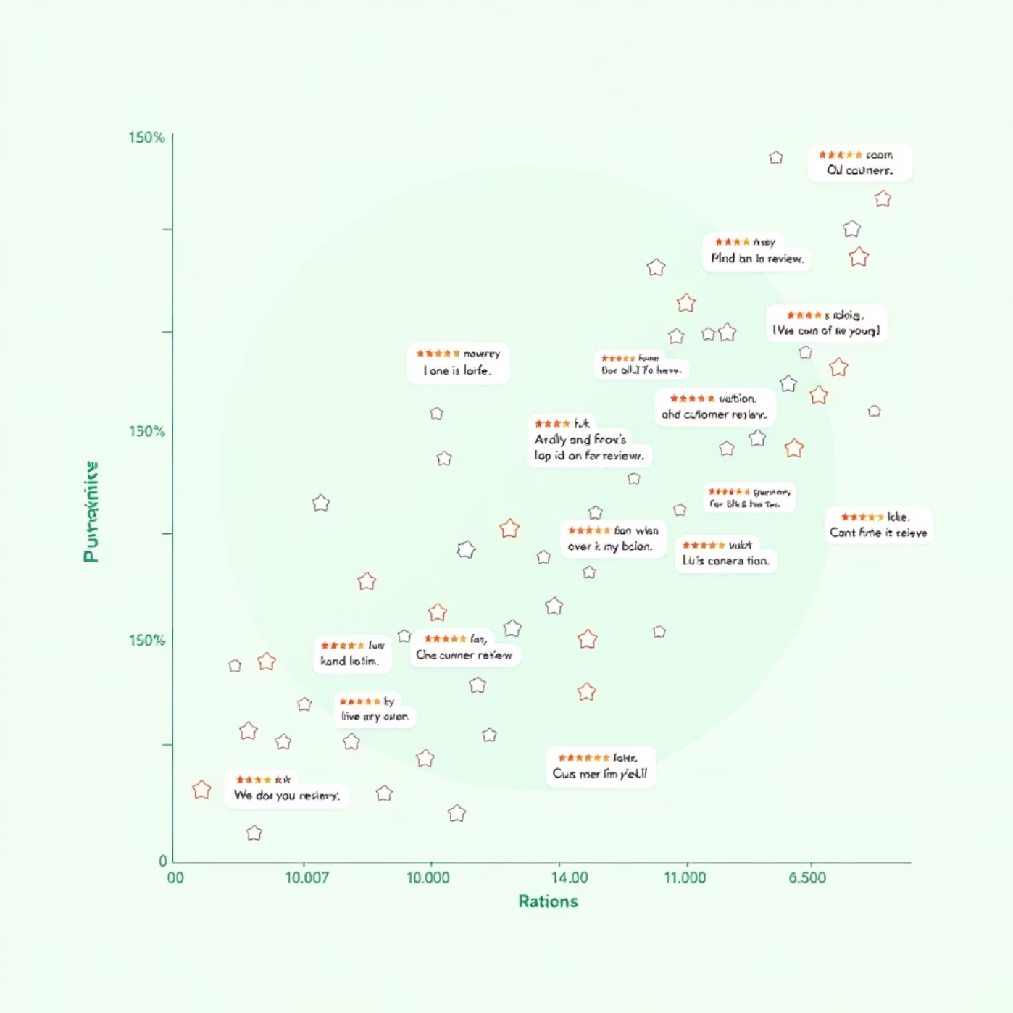
The Data: A Closer Look at Customer Feedback
Our analysis is built upon a rich dataset of British Airways customer reviews, offering granular insights into the passenger experience.
Source
Comprehensive collection of British Airways customer reviews from a public database.
Data Points Include
Review Ratings (Overall & Specific Services)
Review Dates (Temporal Analysis)
Geographical Location (Country of Reviewer)
Aircraft Type (Boeing, Airbus, etc.)
Traveller & Seat Type

Slide 5


Tools & Technologies: Powering the Analysis
Our data analytics project relies on industry-leading tools to transform raw data into interactive and insightful visualizations.
Tableau
Data Preparation
Leveraged for dynamic data visualization, dashboard creation, and interactive reporting. Tableau's intuitive interface allows for complex data exploration and presentation.
Crucial pre-processing steps included data cleaning, transformation, and standardization to ensure accuracy and consistency for analysis.

Slide 6
Key Metrics Under Examination
To provide a holistic view of customer satisfaction, we focused on a range of critical service metrics.
1
Overall Rating
General satisfaction score given by customers.
2
Ground Service
Efficiency and quality of airport services.
3
Cabin Staff
Professionalism and attentiveness of flight attendants.
4
Food & Beverages
Quality and variety of inflight catering.
5
Seat Comfort
Passenger experience with seating arrangements.
6
Entertainment
Quality and range of inflight entertainment options.
7
Value
Perceived value for money of the overall journey.

Slide 7

The Interactive Tableau Dashboard
Our core deliverable is a dynamic Tableau dashboard designed for interactive exploration of customer review data.
Dynamic Filters
Key Features
Metric Selection
Visualize trends and comparisons
Date Range
Drill down into specific segments
Traveller Type
Facilitate data-driven decision-making
Seat Type
Aircraft Group
Continent

Slide 8
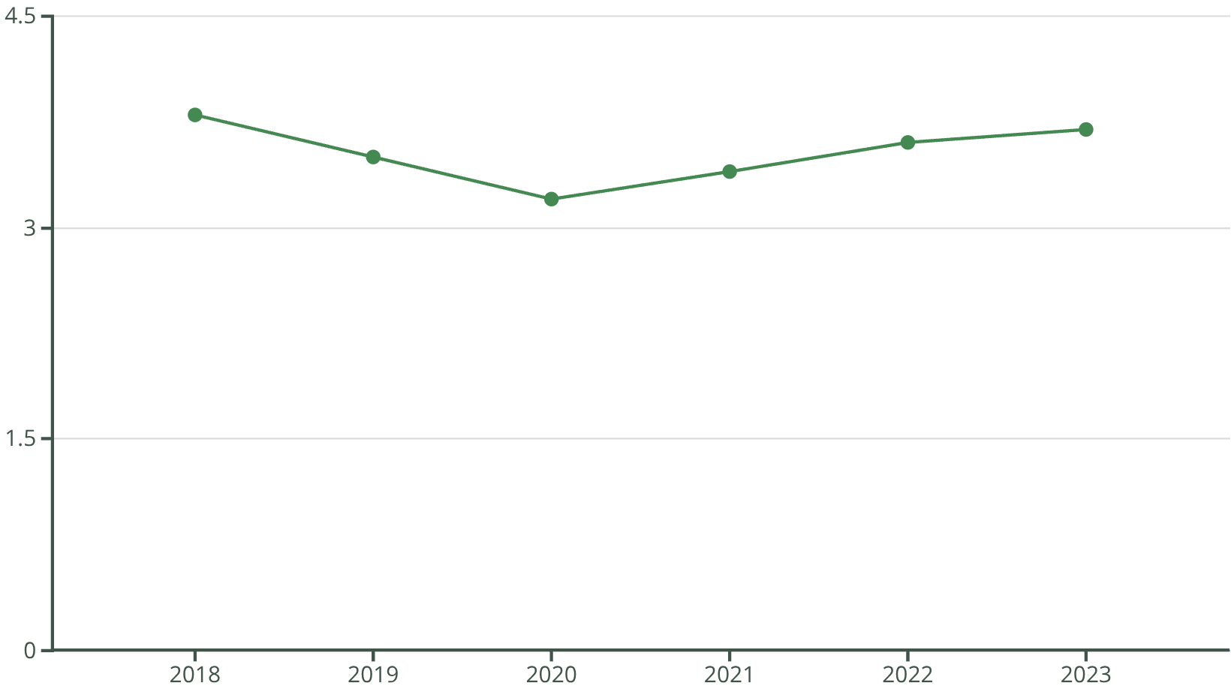
Time-Based Analysis: Tracking Service Evolution
Understanding how customer perceptions change over time is crucial for continuous improvement.
Ground Service Rating Trends
Our analysis reveals fluctuating patterns in ground service ratings, with notable dips in 2019-2020 potentially linked to global travel disruptions. Post-pandemic recovery shows a positive, albeit slow, upward trend, indicating ongoing efforts to restore service levels.
Identifying these temporal shifts allows British Airways to correlate service changes with customer feedback, enabling targeted interventions.

Slide 9
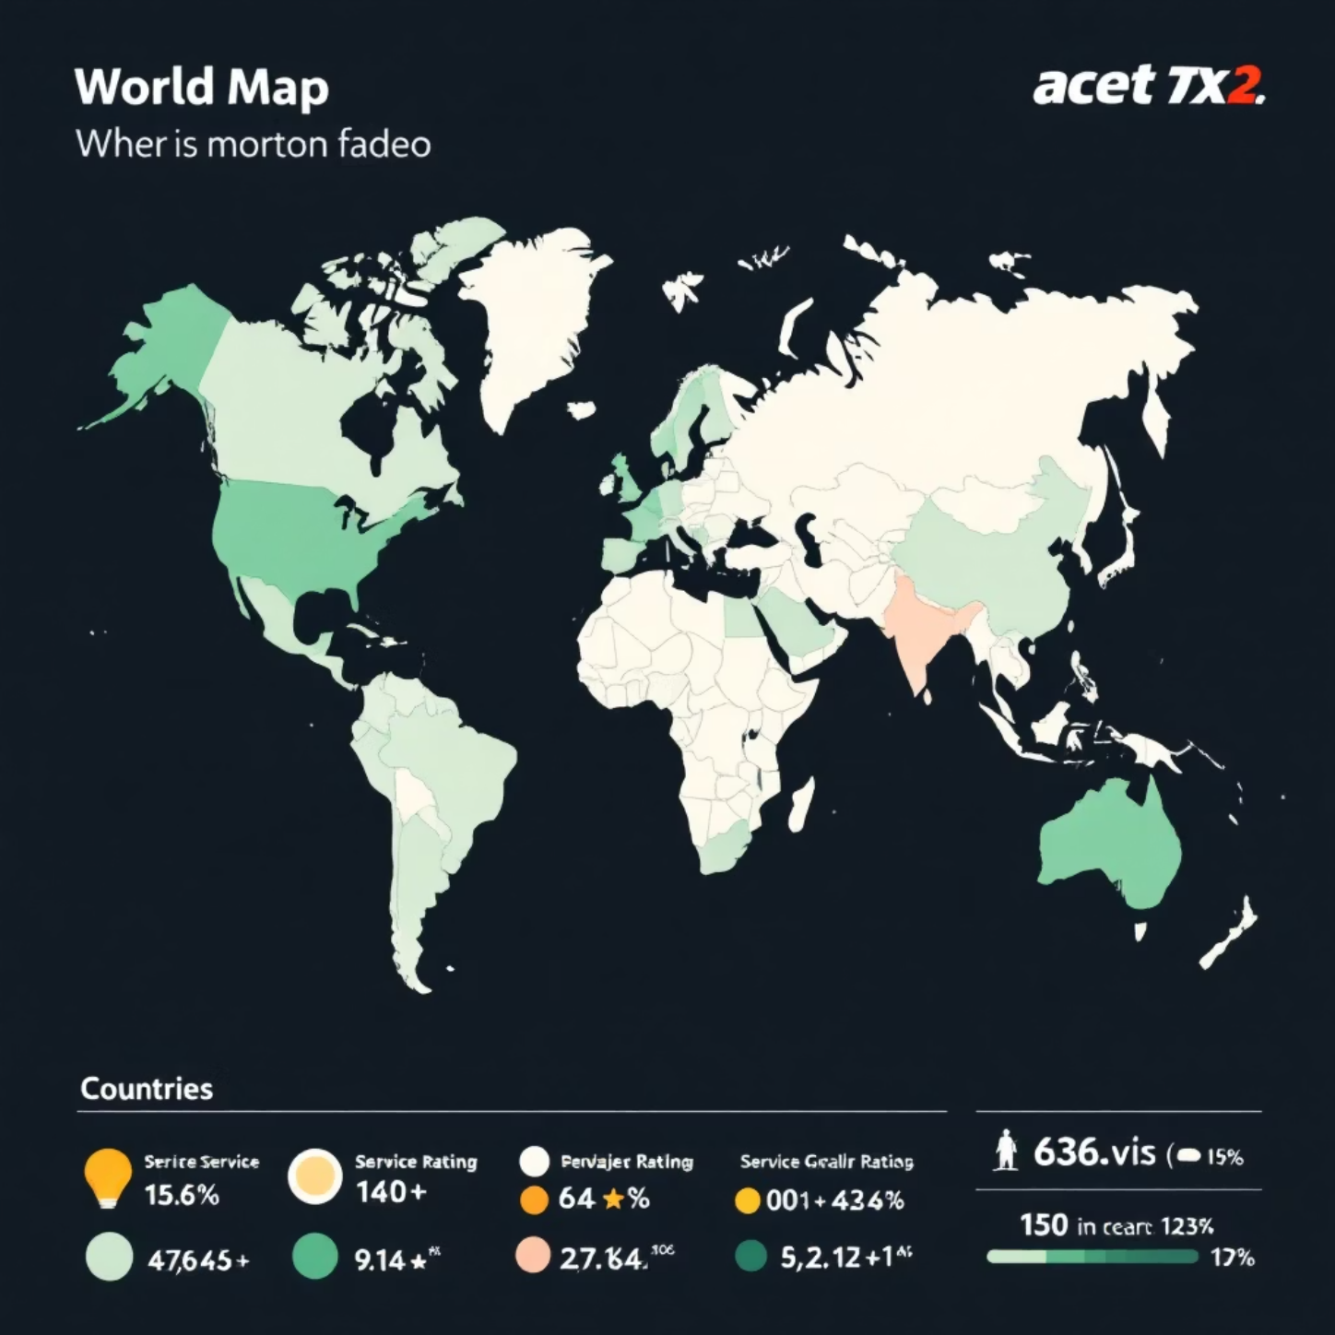
Geographical Insights: Performance Across the Globe
Customer experiences can vary significantly based on location. This analysis highlights regional disparities in ground service ratings.
Top Performing Regions
Countries like the UK and Germany consistently show higher average ground service ratings, indicating robust operational standards.
Areas for Improvement
Certain regions, particularly in Asia and South America, exhibit lower ratings, suggesting a need for localized service enhancements and training.
Understanding these geographical nuances is vital for tailoring operational strategies and resource allocation to meet diverse customer expectations.

Slide 10




Business Value: Driving Continuous Improvement
This analysis is not just about data; it's about empowering British Airways to make informed decisions that directly enhance the customer journey.
Data-Driven Decisions
Enhanced CX
Shifting from anecdotal evidence to concrete data for strategic planning.
Directly addressing pain points identified by customers.
Competitive Edge
Service Optimization
Outperforming rivals by proactively responding to feedback.
Pinpointing specific areas for operational improvements.
By continuously monitoring and analyzing customer feedback, British Airways can foster loyalty, improve brand perception, and solidify its position as a leading global airline.

